Slide 1


Student Learning & Progress Platform
Secure Web Platform for Real-time Academic Growth & Career Support
RICR · NavKalpana Hackathon · NRI / NIST
Footer: NavKalpana Hackathon | Team RICR-NK-0014 | Slide 1

Slide 2

Problem Statement
Students use fragmented tools for courses, assignments, quizzes, attendance and jobs.
No unified, real-time tracking → low engagement, stress, and unclear growth visibility.
Educators lack a single view to spot at-risk students early and provide timely interventions.
[Insert image placeholder: frustrated student juggling apps/books]
Footer: NavKalpana Hackathon | Team RICR-NK-0014 | Slide 2

Slide 3

Project Overview & Objective
Secure web app for registered students — single login, central dashboard.
Modules: Courses, Assignments, Quizzes, Attendance, Learning Support, Progress Tracking, Jobs/Internships, Alumni.
Objective: Real-time synchronization, motivate learners with streaks/leaderboards/OGI, and connect to career opportunities.
[Insert your dashboard screenshot here]
Footer: NavKalpana Hackathon | Team RICR-NK-0014 | Slide 3

Slide 4
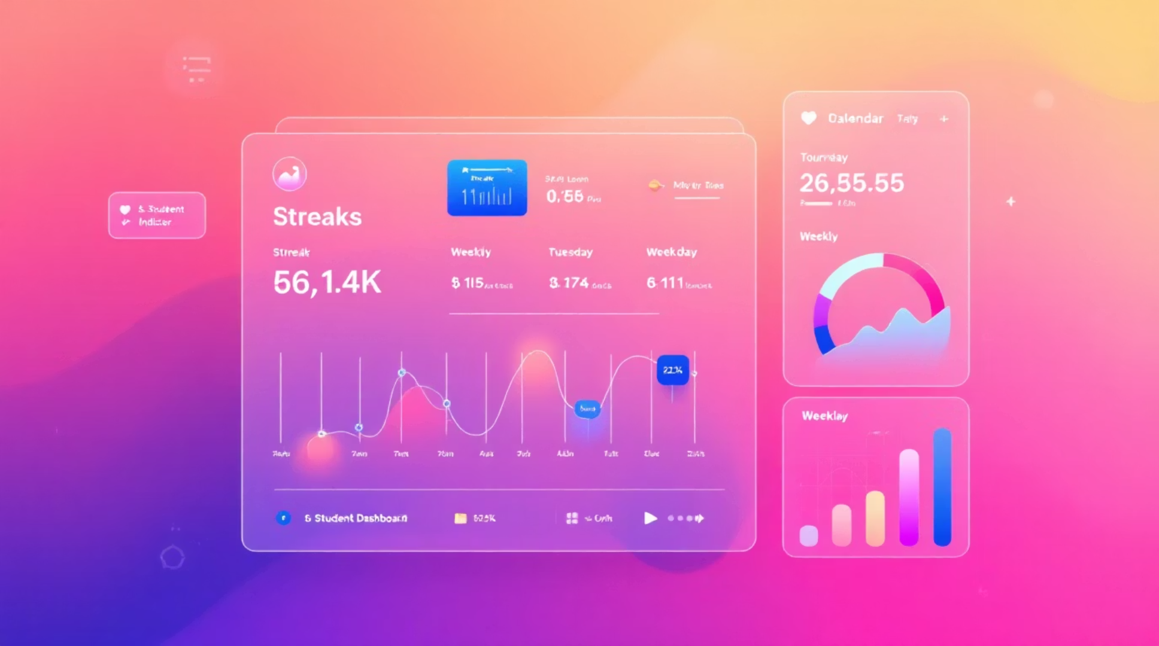

Key Features — Core Foundation
Authentication: Email/password, bcrypt hashing, JWT sessions, logout.
Dashboard: Greeting, Academic Score Card, Assignment summary, Learning Streak, Skills, Weekly chart, Events, Leaderboard.
Courses & Assignments: Progress percentages, mark lessons complete, submit files/text/links, feedback & marks.
Quizzes & Attendance: Timed MCQs, instant scoring, attendance history and doubt submission.
[Insert student dashboard with streak/calendar/chart]
Footer: NavKalpana Hackathon | Team RICR-NK-0014 | Slide 4

Slide 5

Advanced Features — Analytics & Growth
Progress Tracker: Module %, Assignment %, Quiz average, Consistency, OGI value.
OGI Formula: (Quiz Avg × 0.40) + (Assignment Avg × 0.30) + (Completion Rate × 0.20) + (Consistency × 0.10).
Classification: Excellent (85–100), Improving (70–84), Stable (50–69), Needs Attention (<50).
Real-time sync: No page reload — updates on submit/evaluate/complete.
[Insert growth analytics dashboard with charts & badge]
Footer: NavKalpana Hackathon | Team RICR-NK-0014 | Slide 5

Slide 6
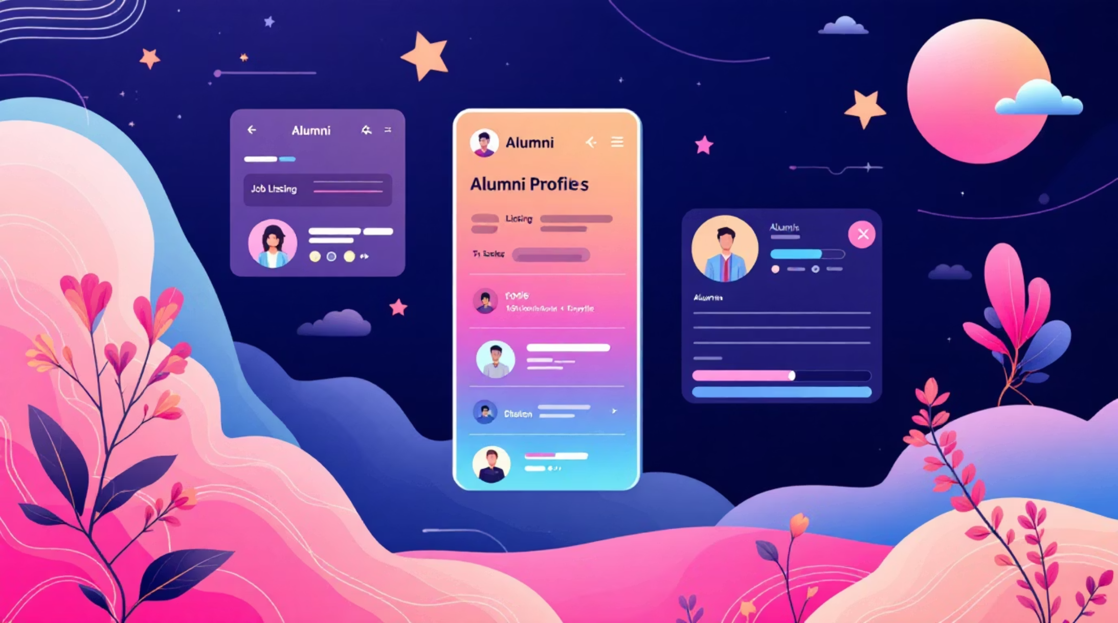

Career Modules
Jobs & Internships: Listings with company, role, required skills, apply link (dummy entries allowed).
Alumni Network: Profiles with company, position, LinkedIn — useful for mentorship & referrals.
Integration: Apply links, CV upload, and filtered search by skill/location.
[Insert job listing card or alumni profile example]
Footer: NavKalpana Hackathon | Team RICR-NK-0014 | Slide 6

Slide 7
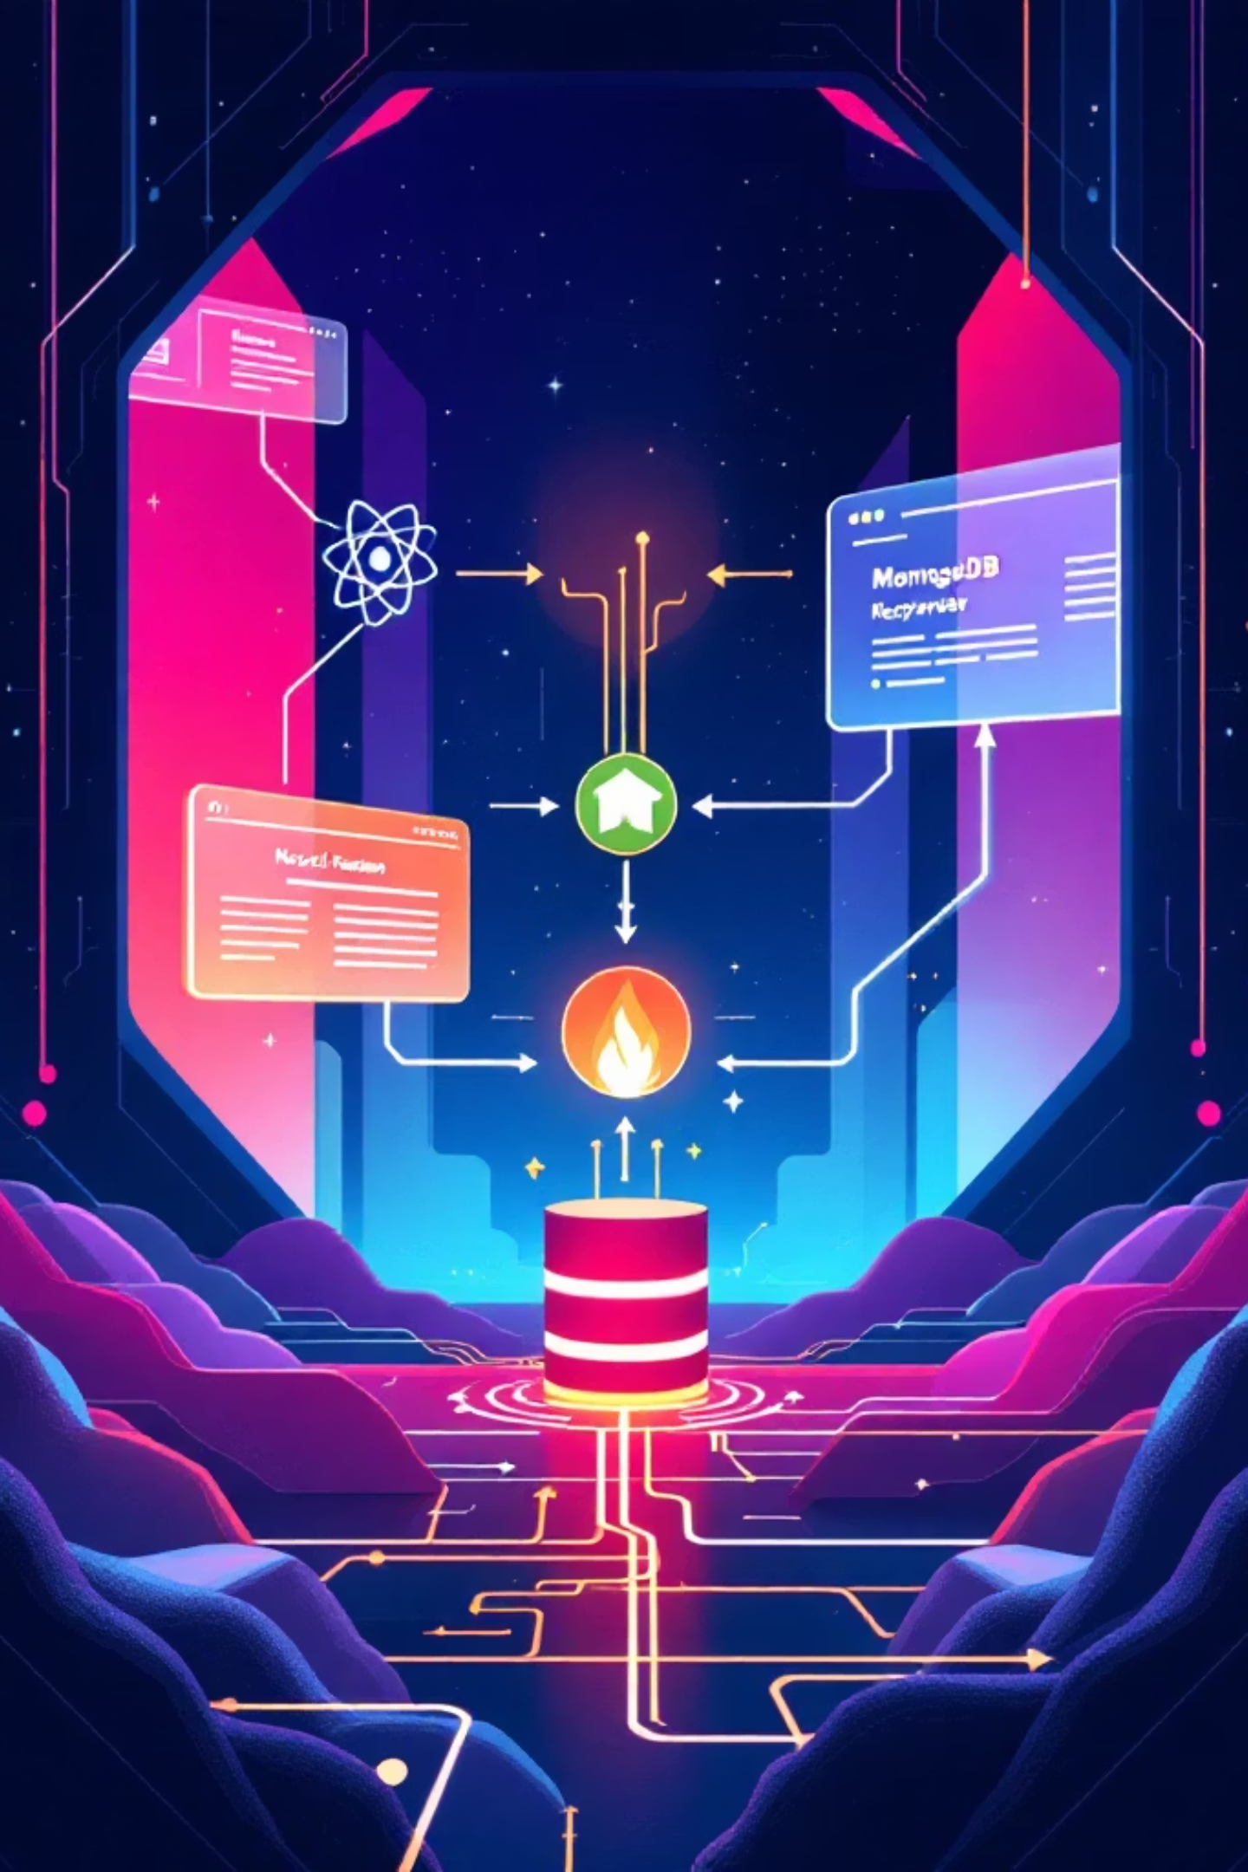
Technology Stack & Architecture
Stack: MERN — MongoDB, Express.js, React.js, Node.js.
Frontend: React with Tailwind/CSS, Chart.js for charts and real-time visual updates.
Backend: Node + Express APIs, JWT authentication, bcrypt for passwords.
Database: MongoDB schemas: users, courses, assignments, quizzes, progress.
Real-time approach: State management + API sync (no polling for most updates). Chat uses socekt.io integration.
Footer: NavKalpana Hackathon | Team RICR-NK-0014 | Slide 7

Slide 8
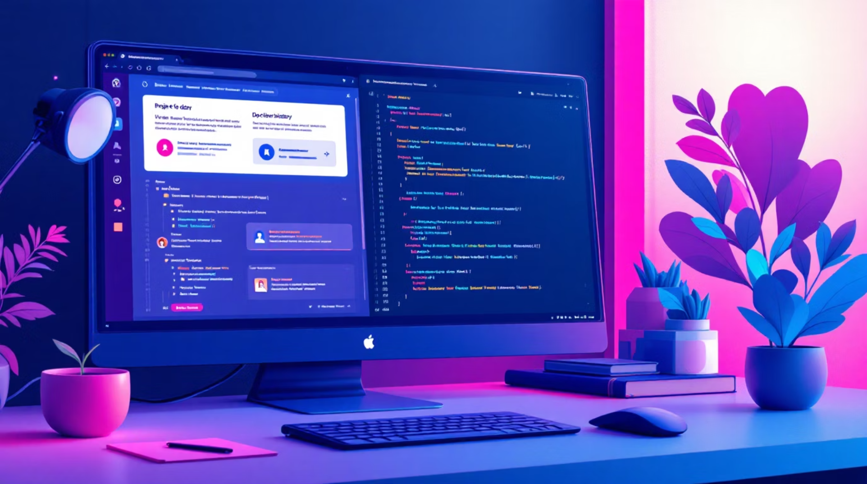

Technical Highlights & Implementation
Instant recalculation of OGI and dashboard metrics on user actions.
Security: bcrypt hashing, JWT sessions (approx. 24h timeout).
Git: 10+ meaningful commits, feature branches, full team contributions.
Deployment: Recommended Vercel / Render — include live link if deployed.
Code hygiene: Clear folder structure, README and setup instructions included.
[Insert git history or folder structure screenshot]
Footer: NavKalpana Hackathon | Team RICR-NK-0014 | Slide 8

Slide 9

Innovation & Bonus Points
Unique Overall Growth Index (OGI) with classification badge for quick insight.
Meaningful real-time synchronization across modules for immediate feedback.
Clean, responsive UI/UX designed for accessibility and mobile-readiness.
Scalable architecture with future AI/ML scope for personalized recommendations.
[Insert OGI badge and innovation icons]
Footer: NavKalpana Hackathon | Team RICR-NK-0014 | Slide 9

Slide 10
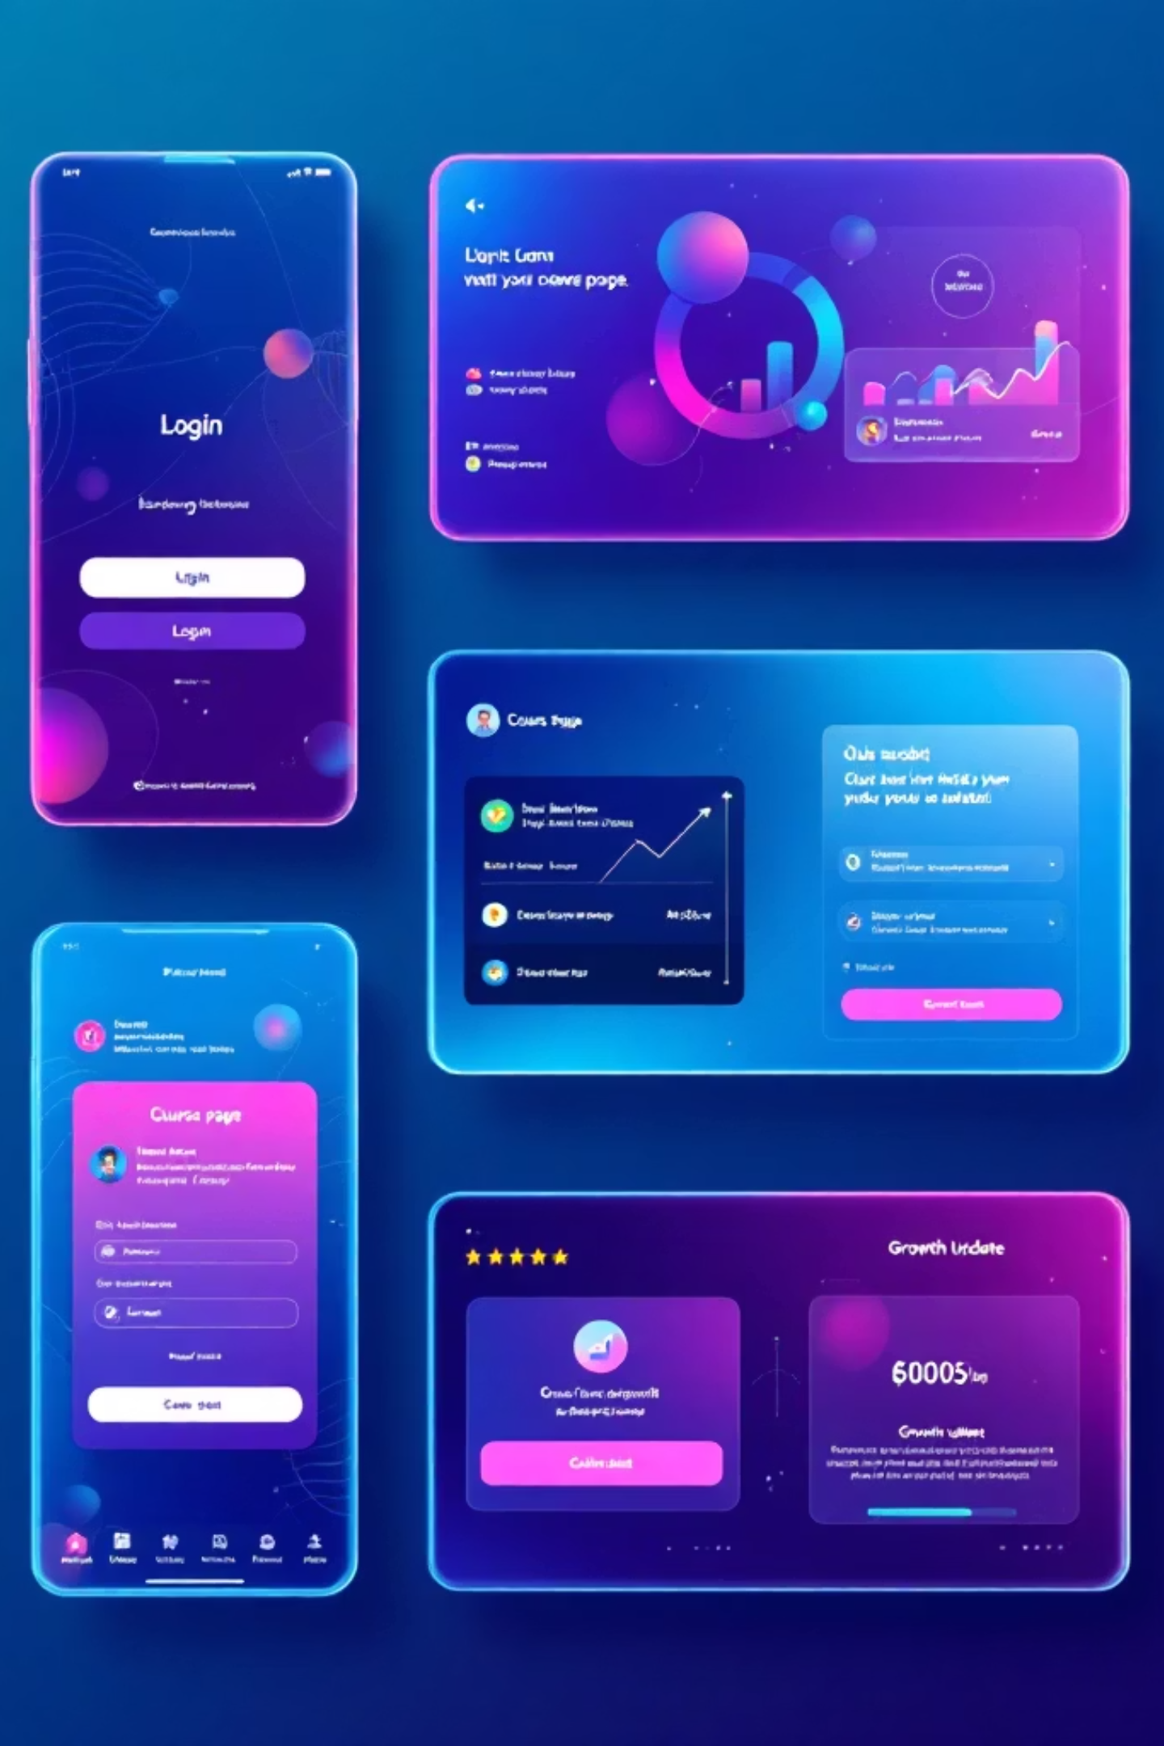
Demo Flow / Screenshots
Login → Central Dashboard.
Open Course → Mark Lesson / Course Complete.
Submit Assignment / Take Quiz → Automatic evaluation.
Growth Dashboard → OGI updates live.
[Insert 4–6 screenshots of your working app here — login, dashboard, course, quiz, growth]
Footer: NavKalpana Hackathon | Team RICR-NK-0014 | Slide 10

